Slide 1
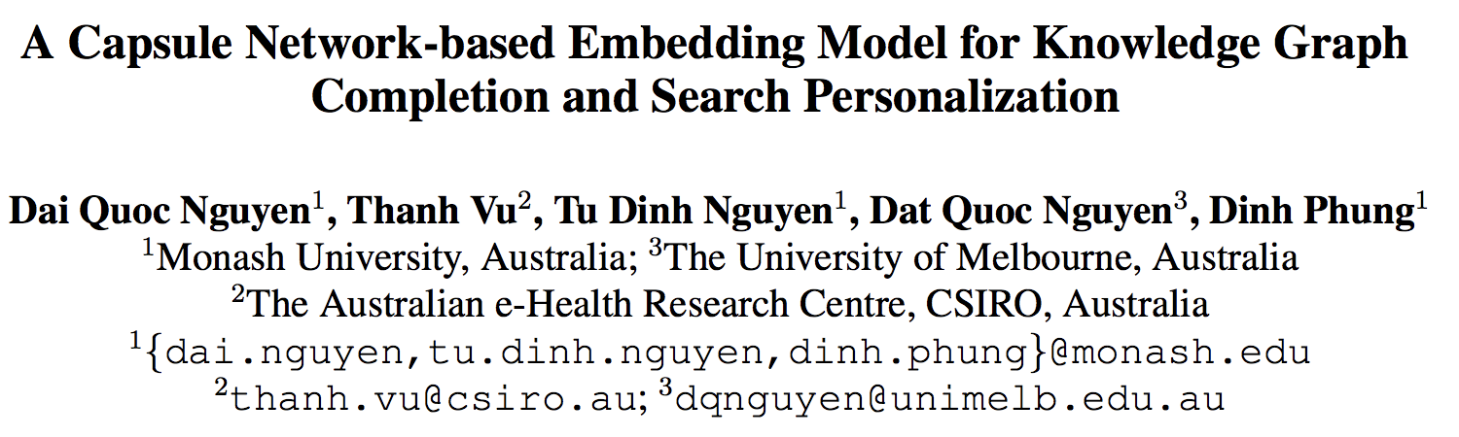

Slide 2
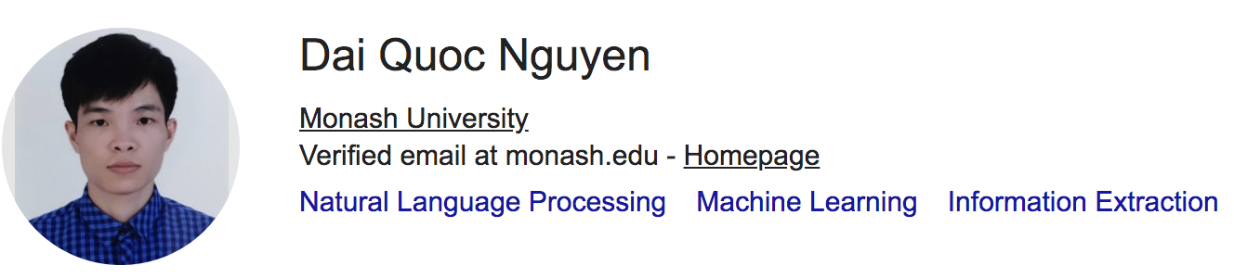




Slide 3
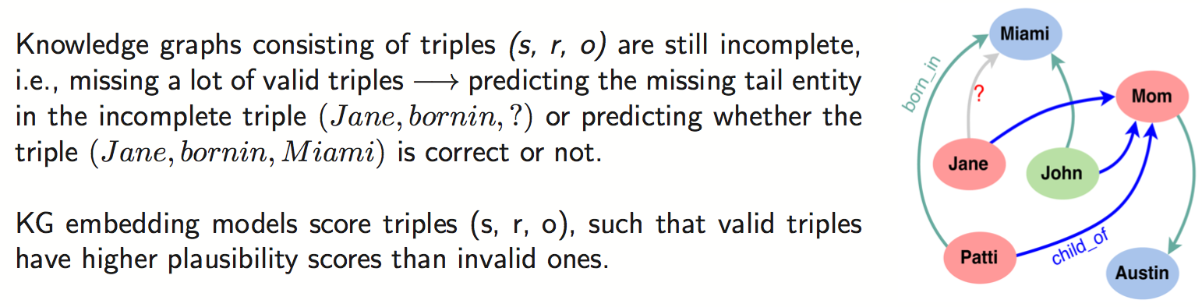
Introduction
Search personalization:
Aim to tailor search results to each specific user based on the user’s personal interests and preferences
Triples can be formulated as (submitted query, user profile, returned document)
Re-rank documents returned to a user given an input query, by employing an existing KG embedding method.

Slide 4
Introduction
Shortcoming:
Conventional embedding models (TransE, DISTMULT, ComplEx) use addition, subtraction or simple multiplication operators, only capture the linear relationships between entities.
Models which applying neural networks (ConvKB) not “deep” enough.
The characteristics of most KG embedding models:
modeling entries at the same dimension of the given triple, where presumably each dimension captures some relation-specific attribute of entities.
CapsNet:
each capsule can encode many characteristics in the embedding triple to represent the entries at the corresponding dimension.
Main contributions:
The first exploring the capsule network to knowledge graph completion and search personalization.

Slide 5
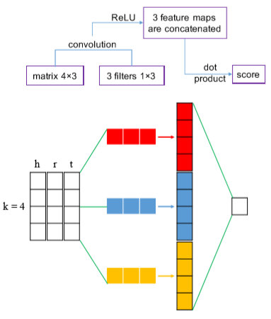
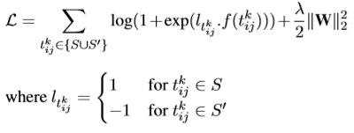
Related work——ConvKB
ConvKB:
each triple (head, relation, tail) is represented as a 3-column matrix.
This 3-column matrix is then fed to a convolution layer to generate different feature maps.
These feature maps are then concatenated into a single feature vector which multiplied with a weight vector via a dot product to return a score.
soft-margin loss :

Slide 6
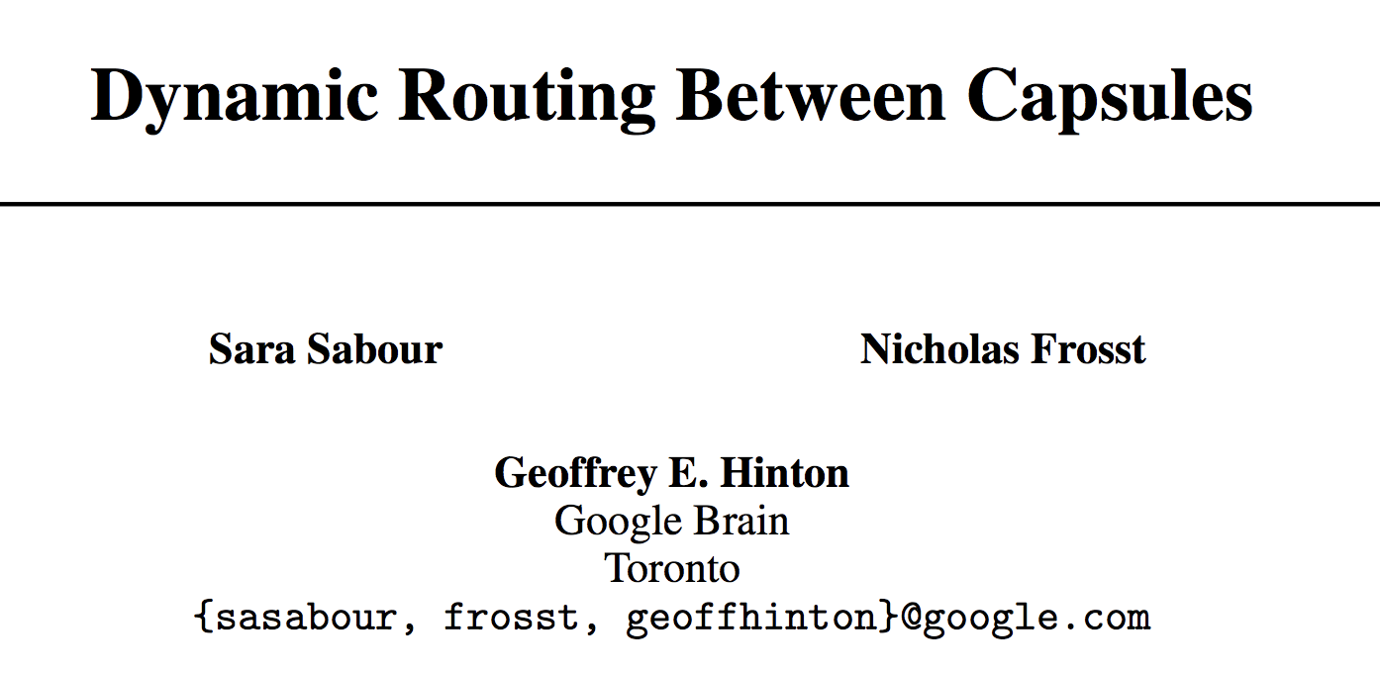
Capsule Networks

Slide 7
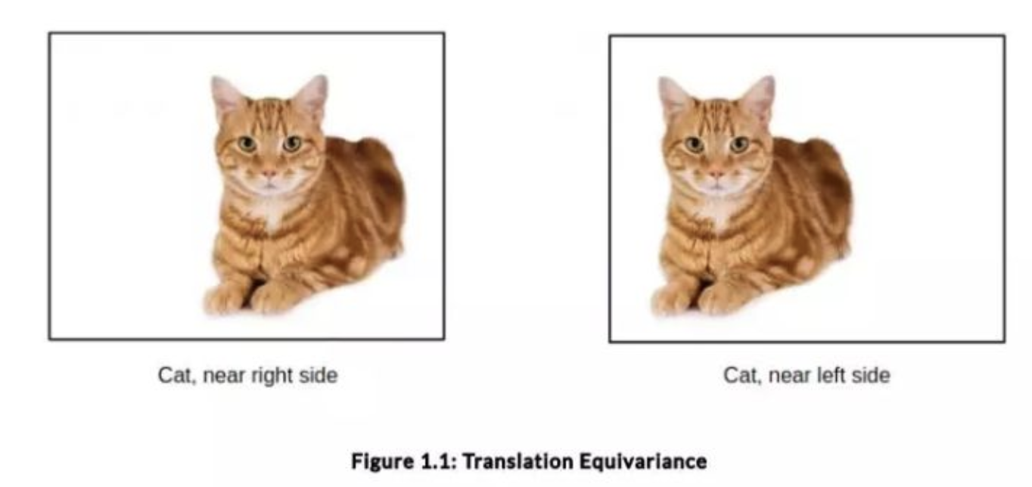
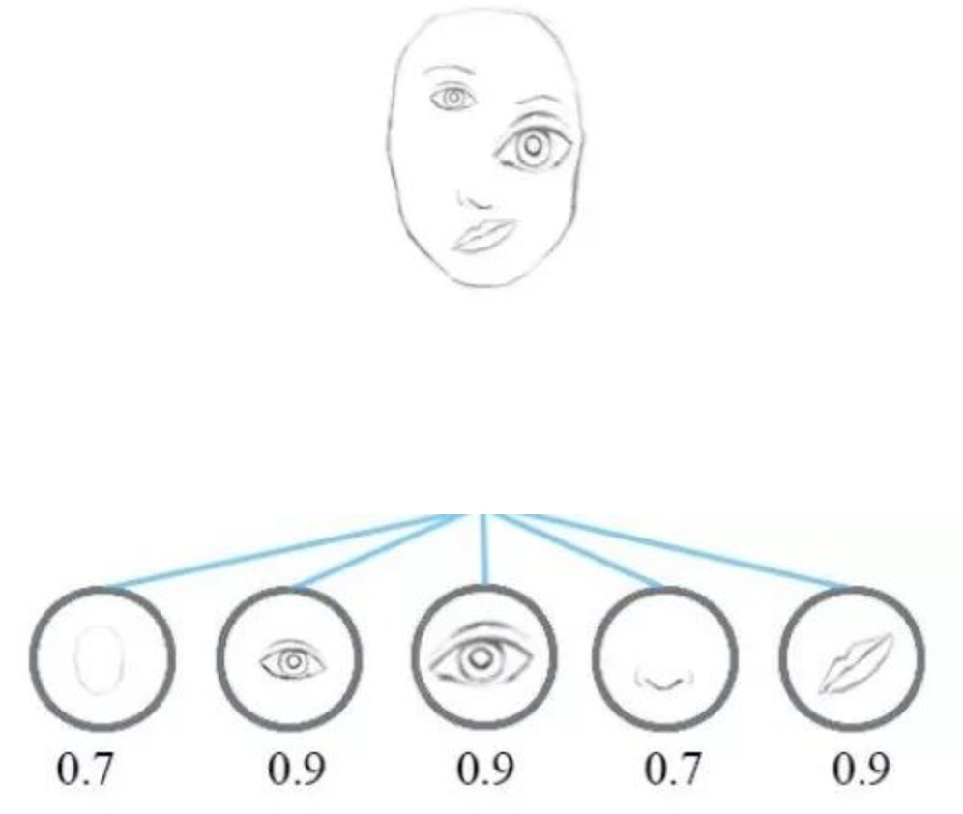
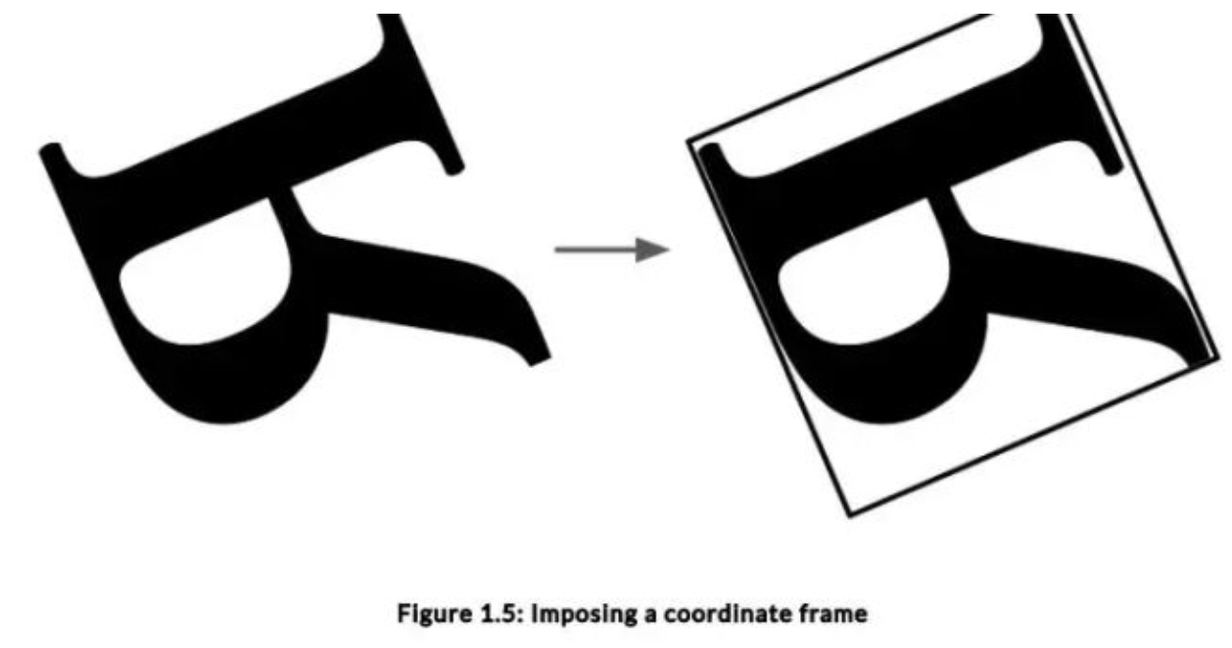
Problems of CNN

Slide 8
Problems of CNN

Slide 9
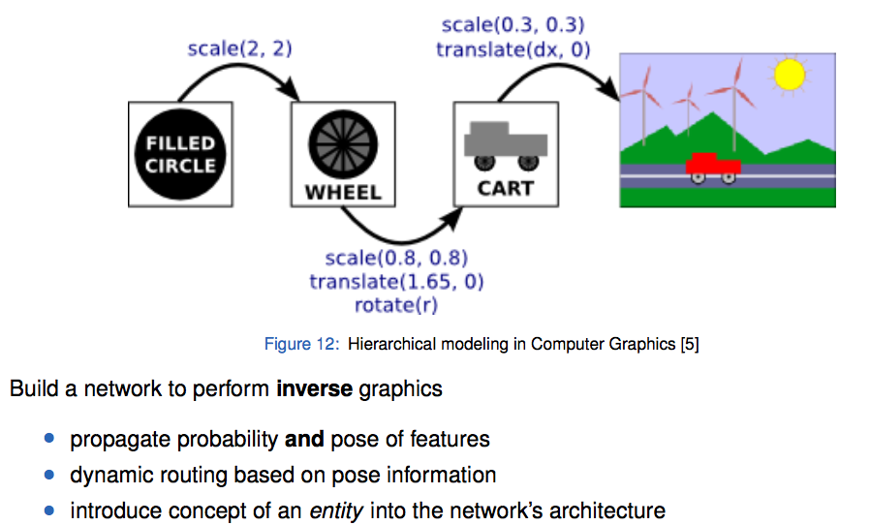
Capsule Networks

Slide 10
Capsule Networks
CNN
CapsNet

Slide 11
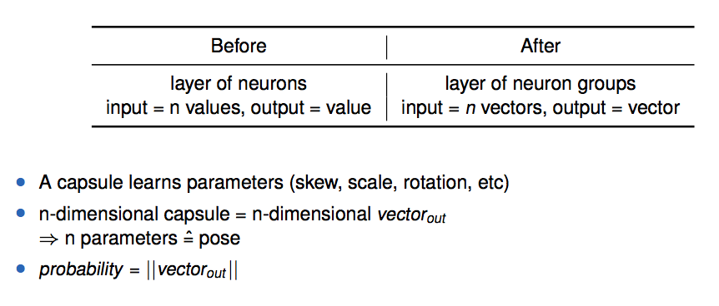
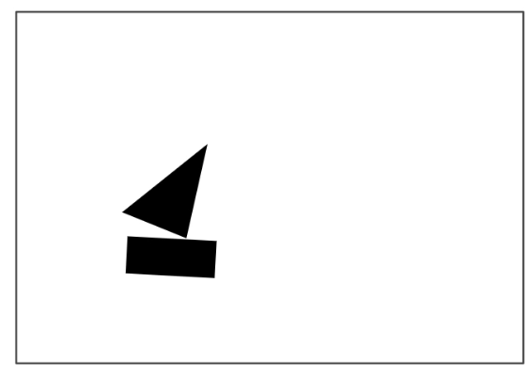
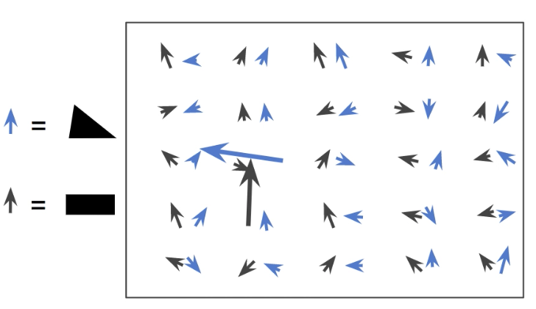
Capsule Networks

Slide 12
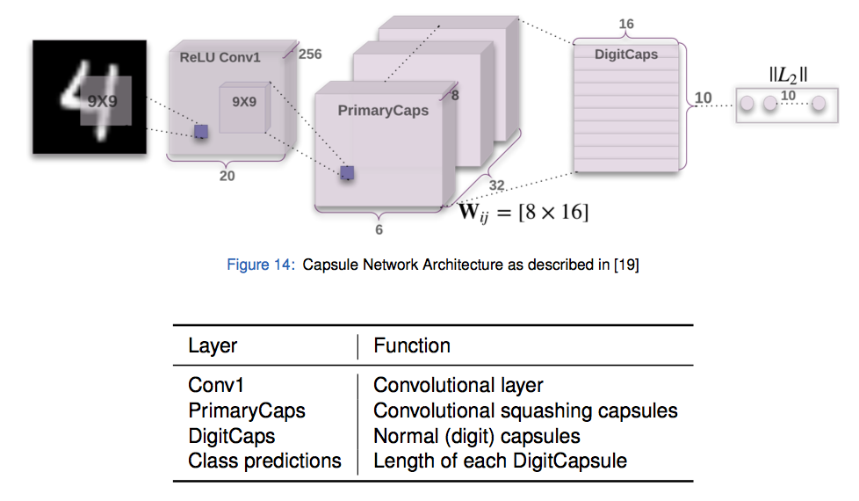
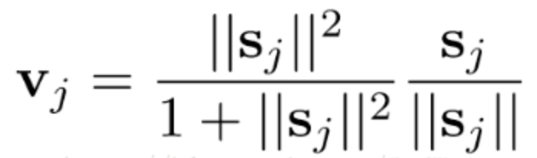
Architecture
Squashing:

Slide 13
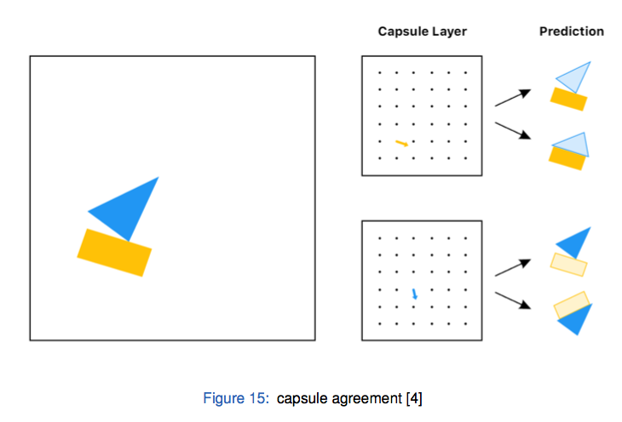
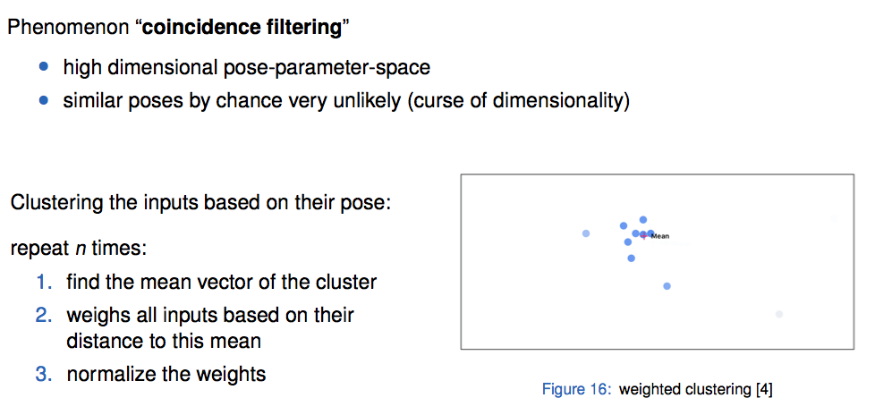
Routing-by-agreement

Slide 14
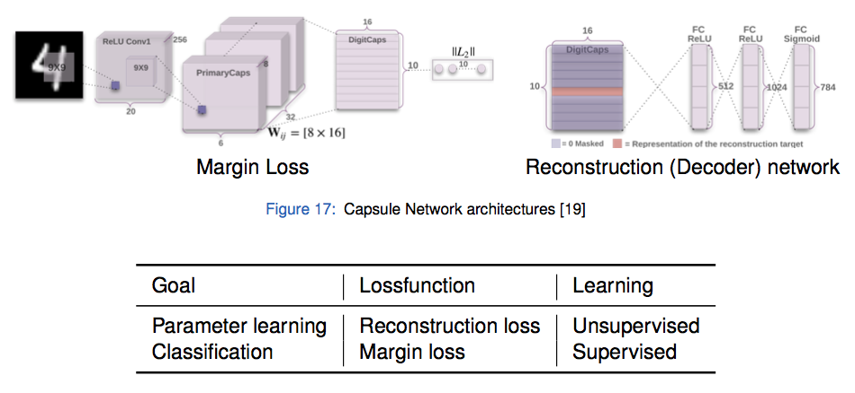
Train the network

Slide 15
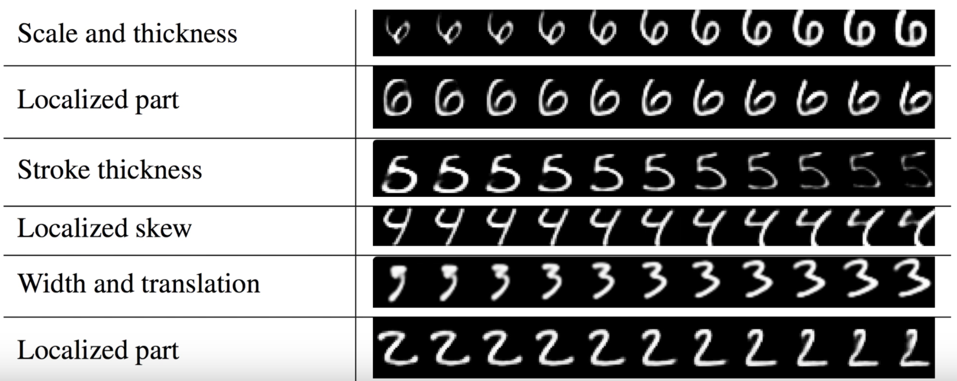
MNIST

Slide 16
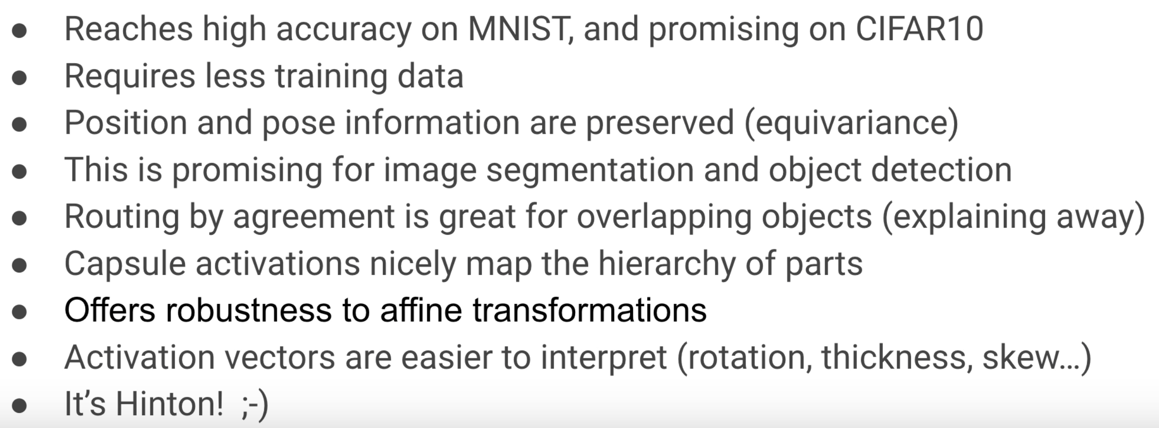
Pros

Slide 17
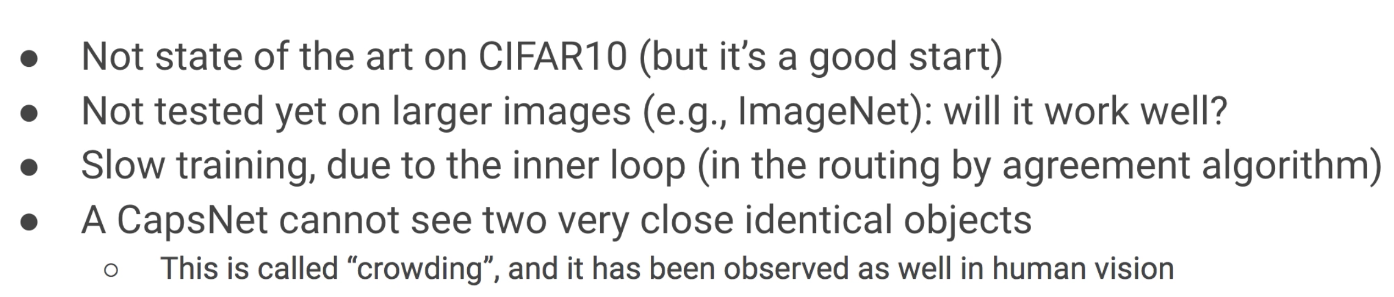
Cons

Slide 18
CapsNet → CapsE
CapsNet:
Employ capsules (i.e., each capsule is a group of neurons) to capture entities in images and then uses a routing process to specify connections from capsules in a layer to those in the next layer.
Each capsule accounts for capturing variations of an object or object part in the image, which can be efficiently visualized.
Hypothesis:
Embedding entries at the same dimension of the triple also have these variations, although it is not straightforward to be visually examined.

Slide 19
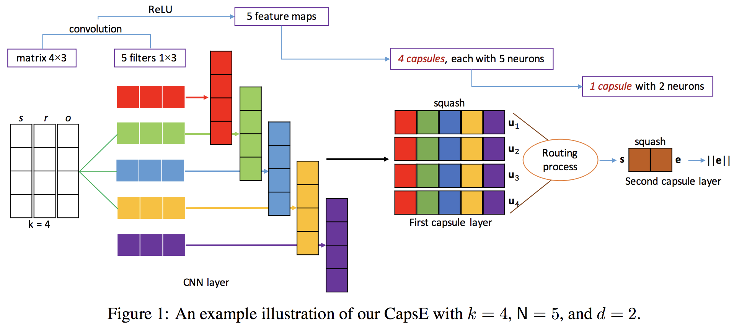
CapsE
Each capsule can capture many characteristics among the entries at the corresponding dimension in the embedding triple.

Slide 20
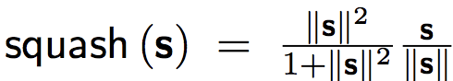
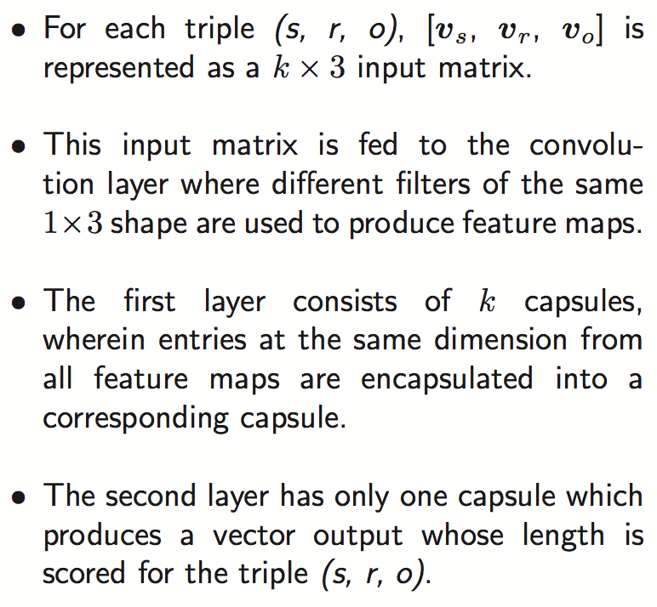
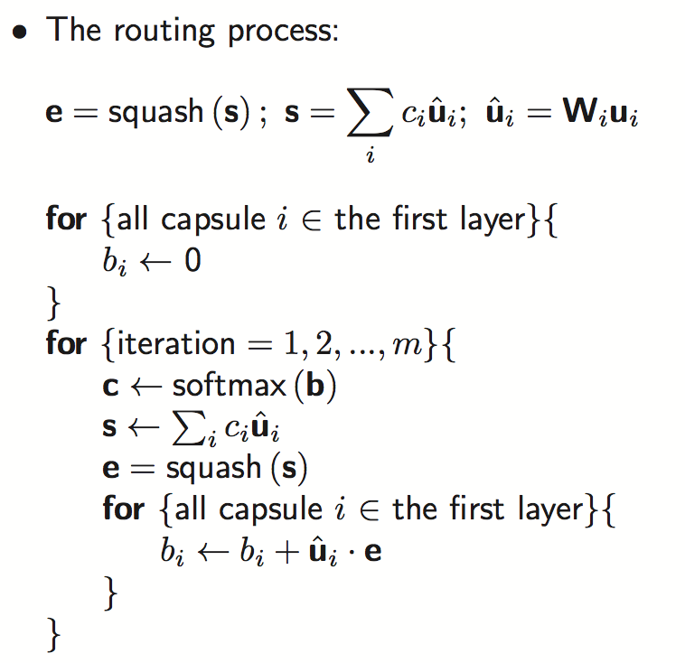
CapsE

Slide 21
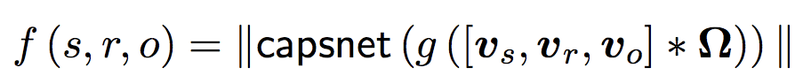
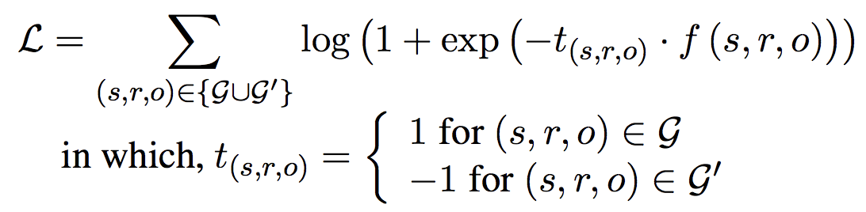
Training Objective
Scoring function:
Loss function:

Slide 22
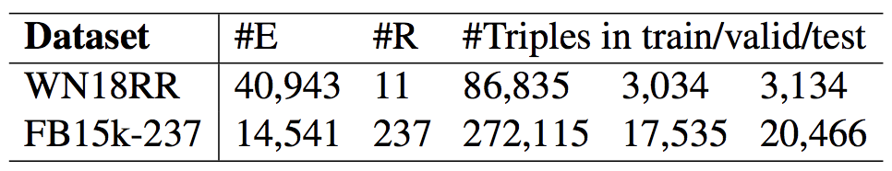
Knowledge graph completion
Datasets:
Created to avoid reversible relation problems, thus the prediction task becomes more realistic and hence more challenging
Evaluation protocol: filtered setting
Not taking any corrupted triples that appear in the KG into accounts.
Training protocol:
Use common Bernoulli strategy to sample invalid triples
Initialized by pre-trained entity and relation embeddings produced by TransE

Slide 23
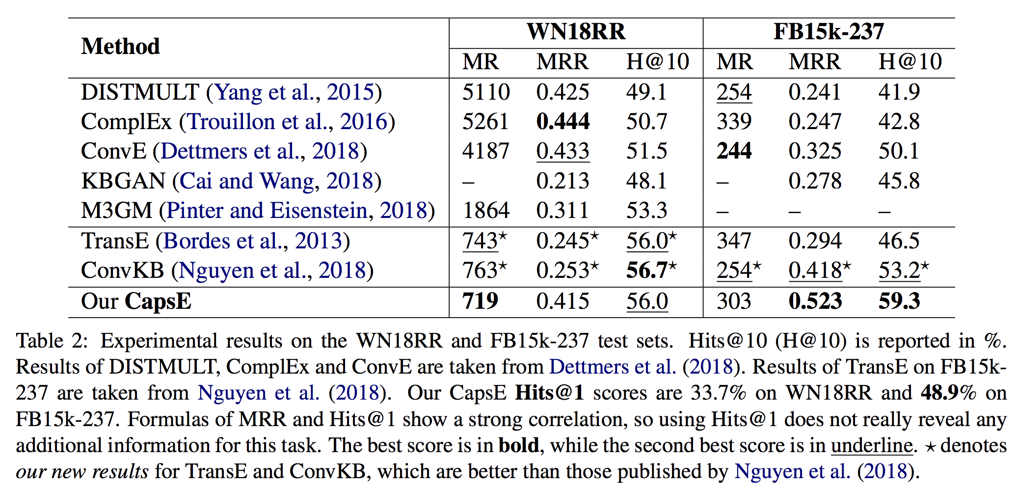
Results and Analysis
CapsE obtains the best MR score on WN18RR and the highest MRR and Hits@10 scores on FB15k-237.

Slide 24
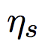
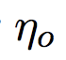
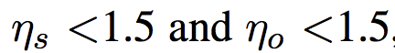
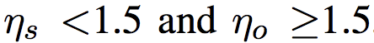
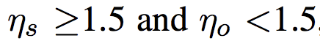
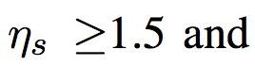
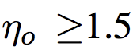
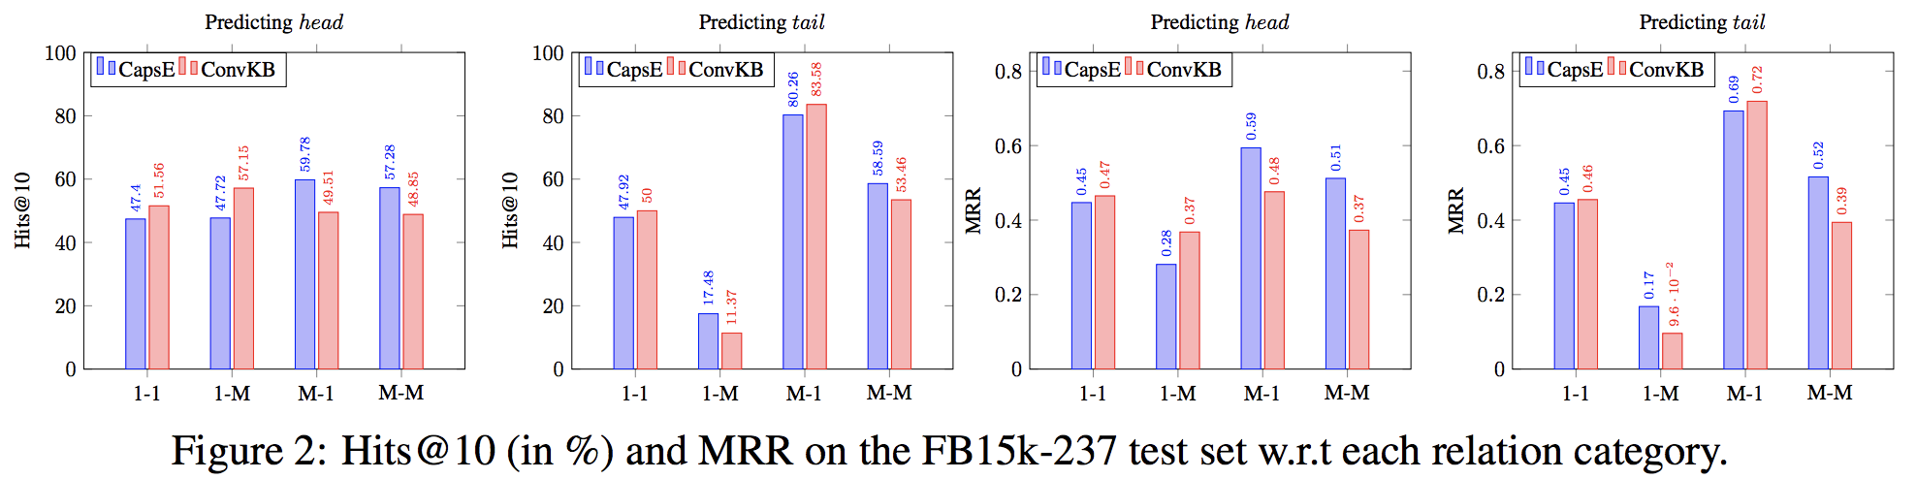
Analysis of relation category
The averaged number of head entities per tail entity and the averaged number of tail entities per head entity.
: 1-1 : 1-M
: M-1 : M-M
0.9%, 6.3%, 20.5% and 72.3% of the test triples in FB15k-237 contain 1-1, 1-M, M-1 and M-M relations.

Slide 25
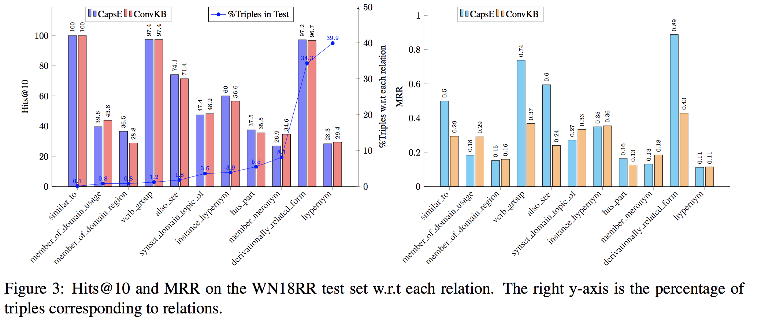
Analysis of relation category
“also_see”, “similar_to”, “verb_group” and “derivationally_related_form” are symmetric relations which can be considered as M-M relations.
CapsE would be a potential candidate for applications which contain many M-M relations such as search personalization.

Slide 26
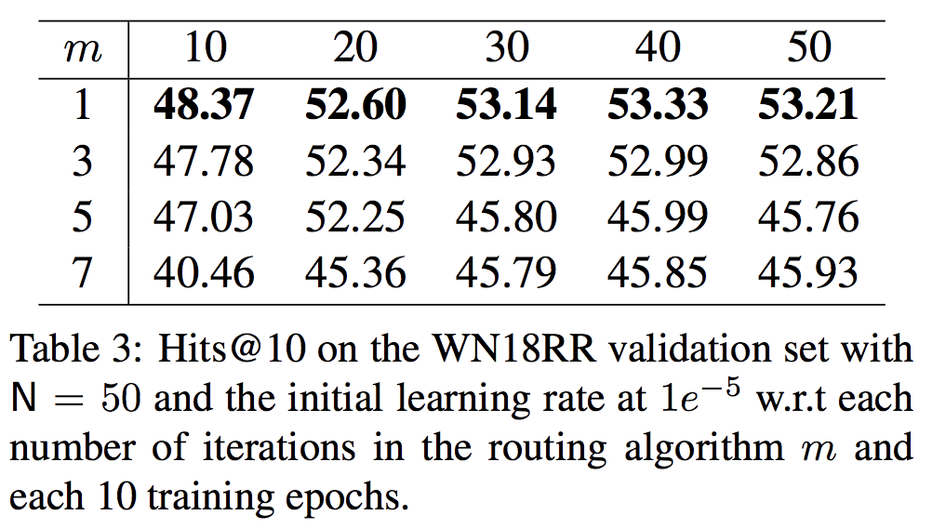
Effects of routing iterations
the best performance for each setup over each 10 epochs is obtained by setting the number m of routing iterations to 1
In the image classification task, setting the number m of iterations in the routing process higher than 1 helps to capture the relative positions of entities in an image (e.g., eyes, nose and mouth) properly.
In contrast, this property from images may be only right for the 1-1 relations, but not for the 1-M, M1 and M-M relations in the KGs because of the high variant of each relation type (e.g., symmetric relations) among different entities.

Slide 27
Search personalization application
Description:
Given a user, a submitted query and the documents returned by a search system for that query, our approach is to re-rank the returned documents so that the more relevant documents should be ranked higher.
We represent the relationship between the submitted query, the user and the returned document as a (s, r, o)-like triple (query, user, document).
The triple captures how much interest a user puts on a document given a query.
Dataset: SEARCH17
query logs of 106 users collected by a large-scale web search engine. A log entity consists of a user identifier, a query, top10 ranked documents returned by the search engine.
The training, validation and test sets consist of 5,658, 1,184 and 1,210 relevant (i.e., valid) triples; and 40,239, 7,882 and 8,540 irrelevant (i.e., invalid) triples, respectively.

Slide 28
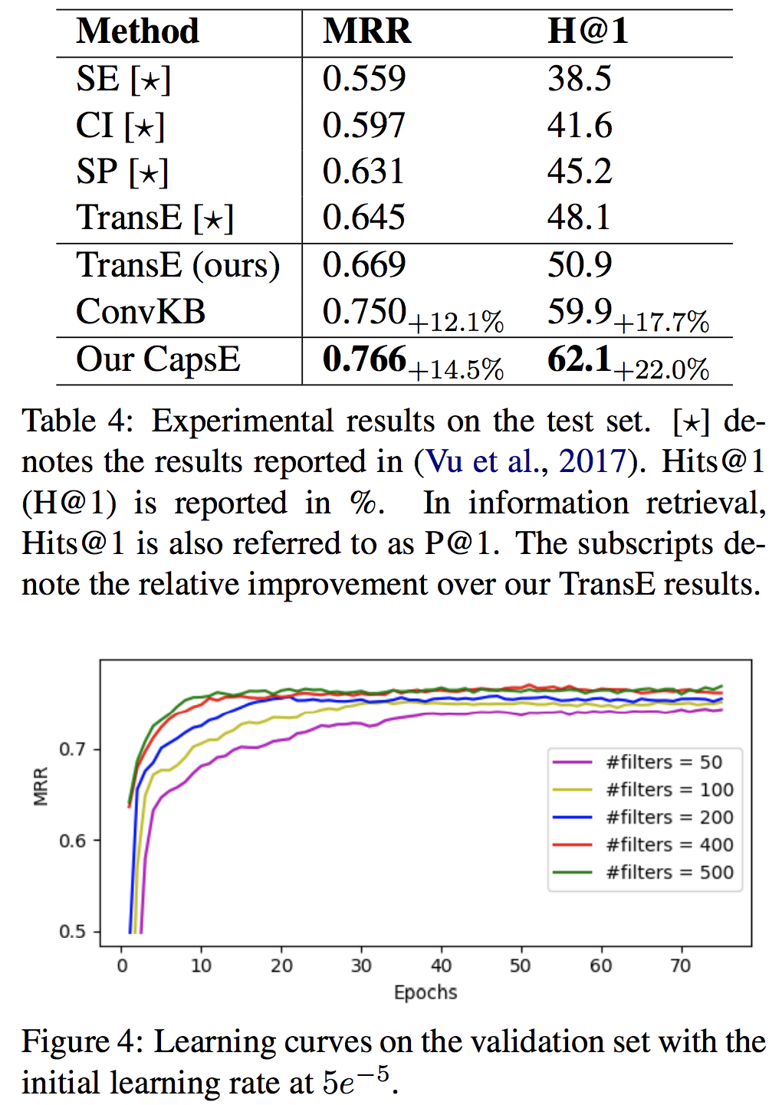
Results
Baselines:
SE: The original rank is returned by the search engine.
CI: uses a personalized navigation method based on previously clicking returned documents.
SP: makes use of the session-based user profiles.
TransE: Following Vu et al. (2017)
ConvKB: is the most closely related model to our CapsE.
Analysis:
CapsE achieves the highest performances in both MRR and Hits@1 on SEARCH17.
The performance is improved with the increase in the number of filters since capsules can encode more useful properties for a large embedding size.

Slide 29
Conclusion
CapsE—a novel embedding model using the capsule network to model relationship triples for knowledge graph completion and search personalization.
Experimental results show that CapsE outperforms other state-of-the-art models on two benchmark datasets WN18RR and FB15k-237 for the knowledge graph completion.
The search personalization, in which CapsE outperforms the competitive baselines on the dataset SEARCH17 of the web search query logs.
In addition, CapsE is capable to effectively model many-to-many relationships.

